Slide 1
“THE IMAGINED CITY”
Through studying Sam Selvon’s “Lonely Londoners” (1956) and Colin Macinnes’ “Absolute Beginners” (1959) we see two different versions of London in the 1950’s. These two worlds cross over each other, drawing narratives around the city and enabling us to construct a vision of London at a point of change (Post WWII, at the start of the wind rush generation, and just before the swinging sixties). A time of excitement and freedom, London strikes us as city of both possibility and restriction. A place constructed from opposites, it evokes strong feelings of exhilaration which arise out of a feeling of being at the centre of the world and yet when deconstructed this centre is built out of much smaller stories of loneliness and disappointment. In searching for a place to belong in this hub, London’s outsiders find themselves stuck in a pattern which excludes the possibility of change and progress. Through two very different experiences of London: one of a new London youth and one of the West Indian migrant experience, one thing is clear – London is a multi-dimensional world in which a thousand contradictory lives exist close up to each other but never really touch. As this picture comes into view, we reach a more nuanced understanding of London, one which lacks harmony and encapsulates fractures and divisions- an incomplete and complex sense of reality, but yet one which seems to pervade it’s inhabitants, and despite everything provide a deep pull to the heart.”
Notes:
ners

Slide 2
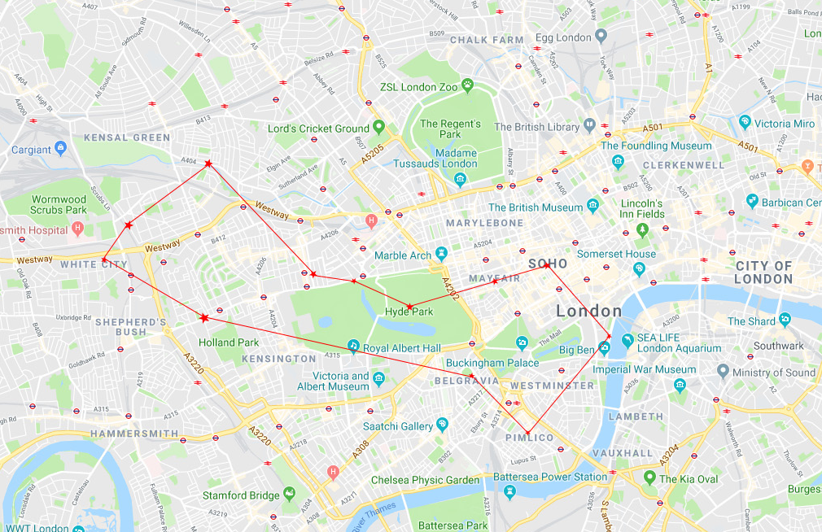
“ABSOLUTE BEGINNERS”: NEW YOUTH LONDON (1959)
“Believe me! Inside the two square miles of Napoli, there was blood and thunder, but just outside it – only across one single road, like some national frontier –you were back in the world of Mrs Dale, and What’s my line? And England’s green and pleasant land. Napoli was like a prison or concentration camp: inside, blue murder, outside, buses and evening papers and hurrying home to sausages and mash and tea.”
Notes:
*Napoli is what Macinnes calls the area of w.10 and w.11.

Slide 3
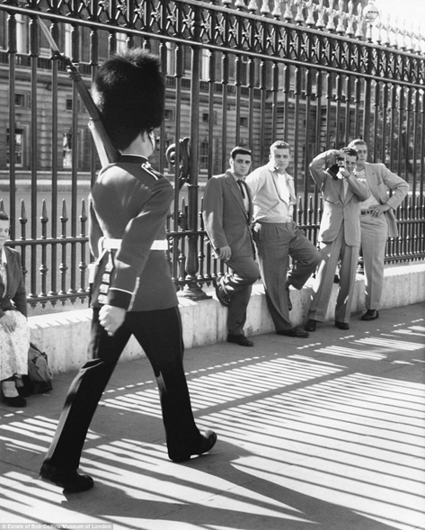
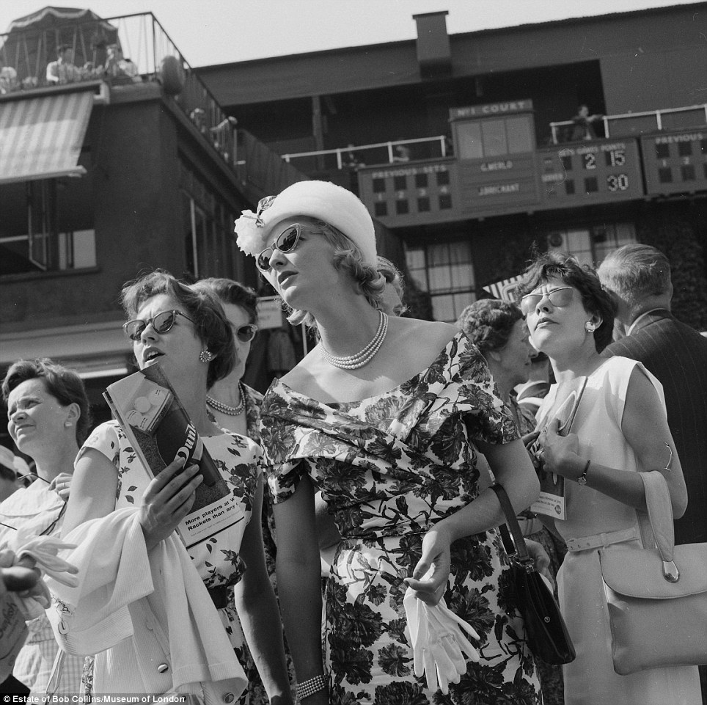
“I see it as an Olde English product like Changing the Guard, or Saville Row suits, or Stilton Cheese in big brown china jars, or any of those things they advertise in Esquire to make the Americans want to visit picturesque Great Britain. The gracious living in the red with huge green squares outside the window, and purring hired and diplomatic vehicles, and everything delivered at the door and on the slate and little restaurants where camp creatures in cotton skin-tight slacks serve half an avocado pear at five bob, cover charge exclusive.”
BELGRAVIA
Notes:
SOURCE: http://www.dailymail.co.uk/news/article-2629449/Iconic-images-London-1950s-60s-captured-street-photographer.html

Slide 4
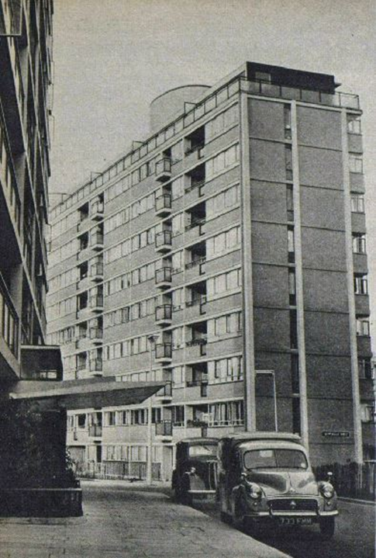
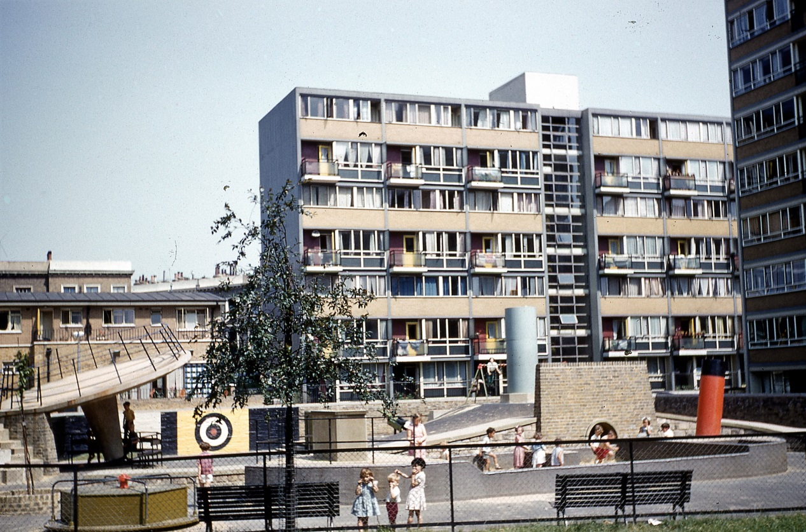
PIMLICO
“Up out in Pimlico, the old, old city raised her bashed grey head again, like she was ashamed of her modern daughter down by the river.”
“Down by the river, where I went to get a breather, I stood beside the big new high blocks of glass-built flats, like an X-ray of a stack of buildings with their skins peeled off”
Notes:
SOURCE:
https://municipaldreams.wordpress.com/2014/05/20/the-churchill-gardens-estate-westminster-like-moving-into-heaven/
https://www.flickr.com/photos/trainsandstuff/36296019370

Slide 5
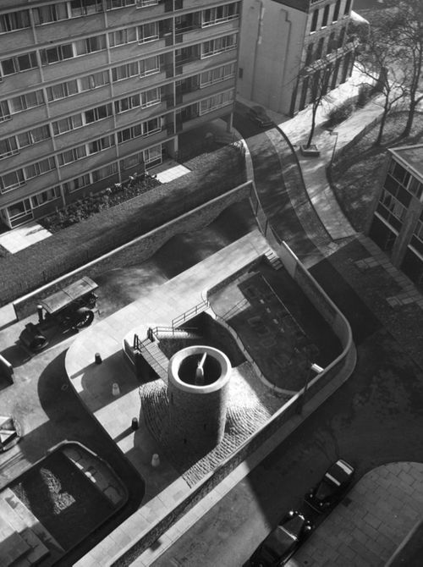
“And there, on the one side, were the glamorous people setting off for foreign countries, mohair and linen suits, white air-liner vanity bags, dark sun-spectacles and pages of tickets packed to paradise, every nationality represented, and everyone equal in the sky- dominion of fast air-travel – and there, on the other side, were the peasant masses of the bus terminal shuffling along in their parlour-curtain dresses and cut-price tweeds and plastic mackintoshes, all flat feet and fair shares and you-in-your-small-corner-and-I-in-mine; and then, passing down the middle of them, a troop of toy soldiers, all of them with hangovers after nights of rapture on the Dilly, and wearing ladies’ fur muffs on their heads and sweaty red jackets that showed their vertebrae's from neck to coccyx, and playing that prissy little pipe music like a bird making wind and I thought, - my god, my lord, how horrible this country is, how dreary, how lifeless, how blind and busy over trifles.”
Notes:
SOURCE: https://www.pinterest.co.uk/pin/352406739565617587/

Slide 6
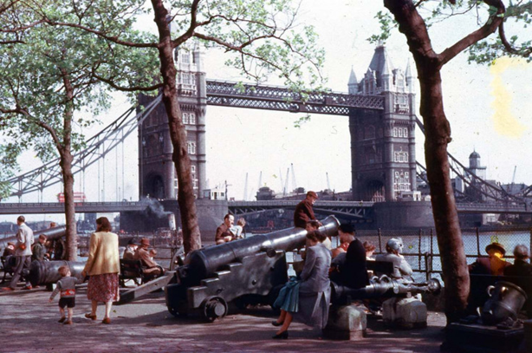
EMBANKMENT
…. Each time I come here for the ride, in any mood, I get a lift, a rise, a bed, as sitter, I thought how, my God, I love this city, horrible though it may be, and never ever want to leave it, come what it may send me.”
Notes:
SOURCE: https://londonist.com/london/best-of-london/london-in-the-1950s

Slide 7
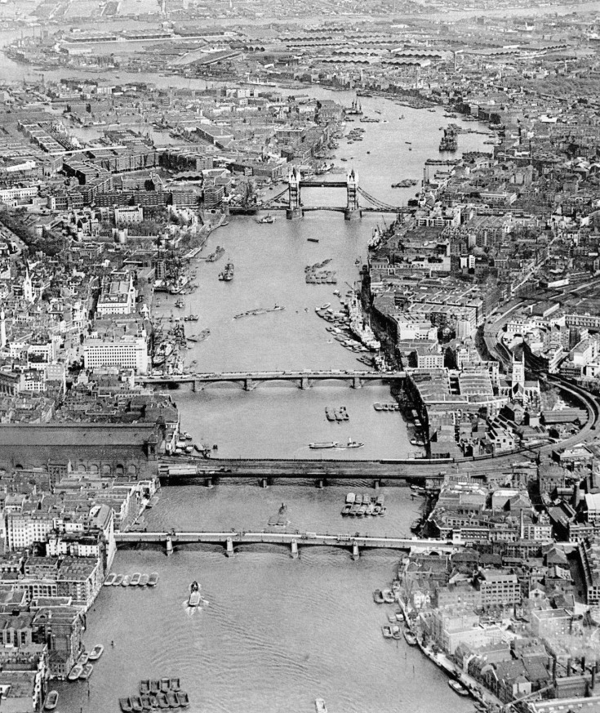
“Whoever thought up the Thames embankment was a genius. It lies curled firm and gentle round the river like a boy does with a girl after it’s over, and it stretches in a great curve from the parliament thing, down there in Westminster, all the way north and east into the city..
Notes:
SOURCE: https://londonist.com/london/best-of-london/london-in-the-1950s

Slide 8
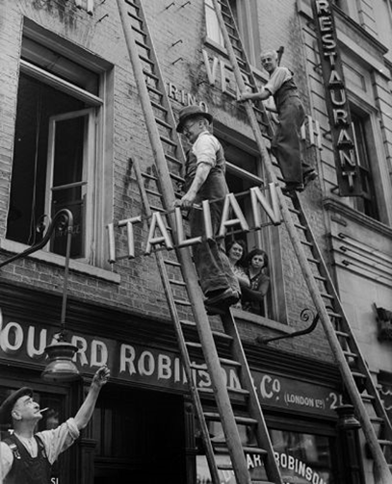
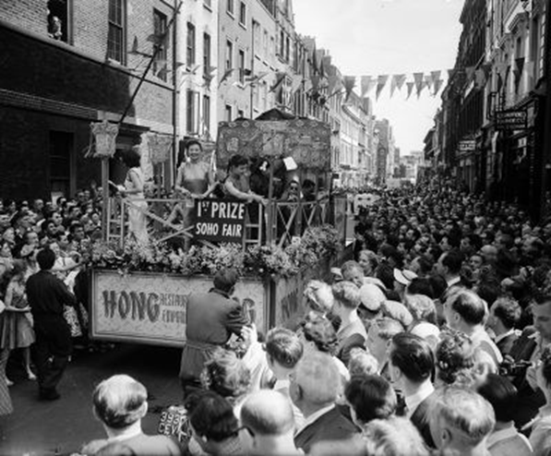
SOHO
“But in Soho, all the things they say happen, do: I mean, the vice of every kink, and speakeasies and spielers and friends who carve each other up, and, on the other hand, dear old Italians and sweet old Viennese who’ve run their honest, unbent little businesses there since the days of George sic, and five, and backward far beyond”
Notes:
SOURCE: http://www.ibtimes.co.uk/save-soho-fascinating-old-photos-vibrant-heart-londons-west-end-over-years-1495269

Slide 9
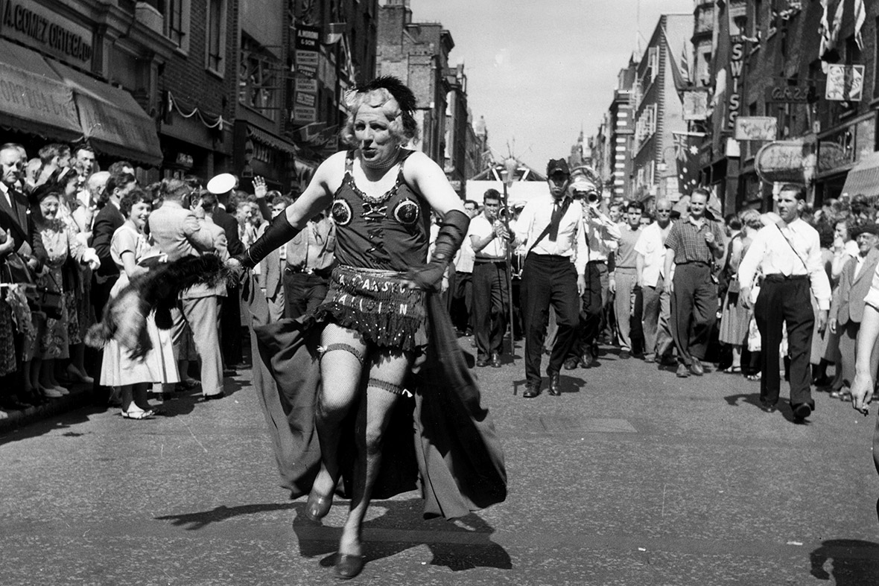
“You don’t go to Soho to watch films because Soho is a film.”
Notes:
SOURCE: http://www.ibtimes.co.uk/save-soho-fascinating-old-photos-vibrant-heart-londons-west-end-over-years-1495269

Slide 10
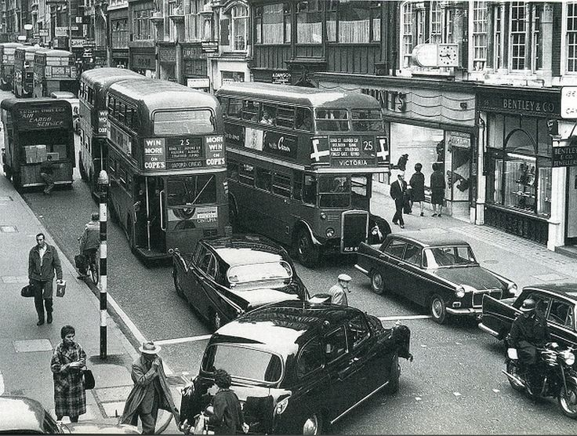
“I can only describe the atmosphere of the joint by telling you it was like a very expensive tomb. Of, course, all the staff had left, and the lights were dim where they ought not to be, which made it all a bit sepulchral, but it did look, as a tomb does, or a monument, like something made very big by people who want to prove something they don’t believe in, but desperately need to.”
MAYFAIR
Notes:
SOURCE: https://www.pinterest.co.uk/pin/536913586807696949/?lp=true

Slide 11
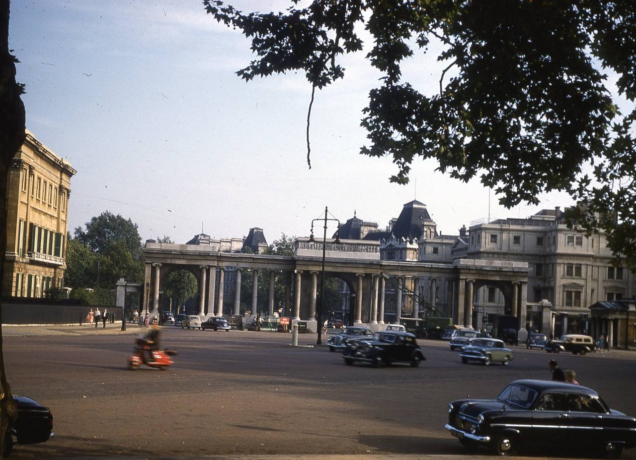
HYDE PARK
“On this north front of the Hyde, the terraces are great white monsters, like the shots you see in films of hotels at the Cote de France.”
Notes:
SOURCE: https://flashbak.com/wonderful-kodachrome-photographs-of-london-in-the-1950s-383308/hyde-park-corner-london-1959/

Slide 12
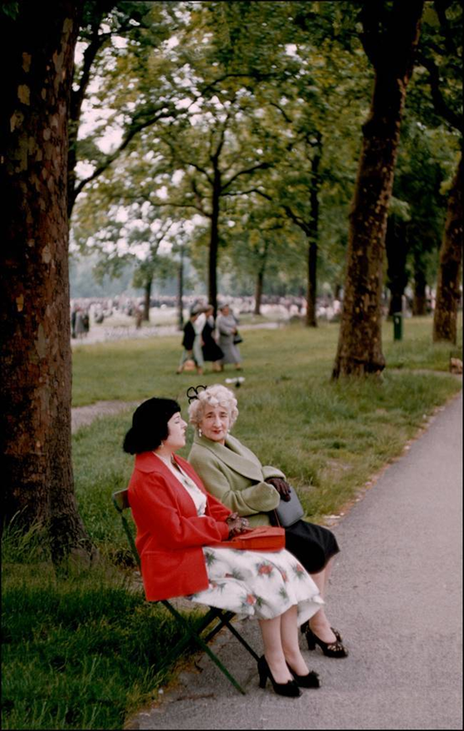
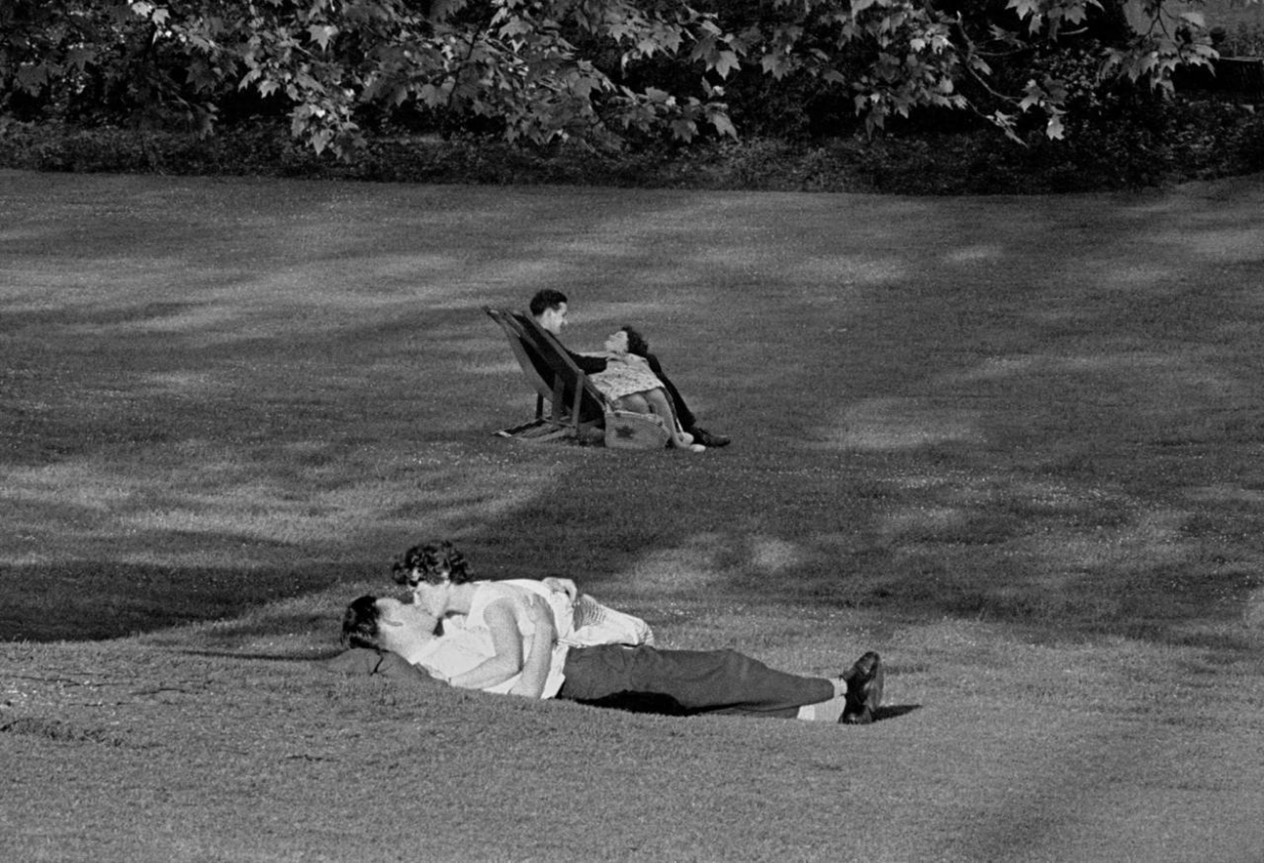
“The thing about the parks is, in day time they’re all innocence and merriment, with dogs and perambulators and old geezers and couples wrapped up like judo performers on the green. But soon as the night falls, the whole scene reverses- into its exact opposite, in fact. In come the prowlers and the gropers and whores and kinky exhibition numbers, and the thick air is filled with hundreds of suspicious, peering pairs of eyes. Everyone is seeking someone, but everyone is scared to meet that him or her they’re looking for.”
Notes:
SOURCE: https://flashbak.com/london-in-the-1950s-frank-horvats-gorgeous-photographs-of-englands-capital-44598/

Slide 13
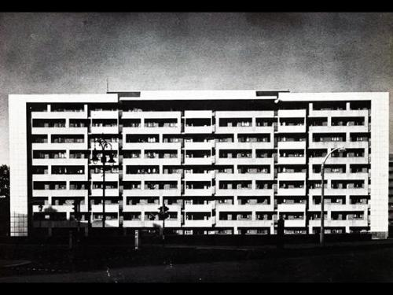
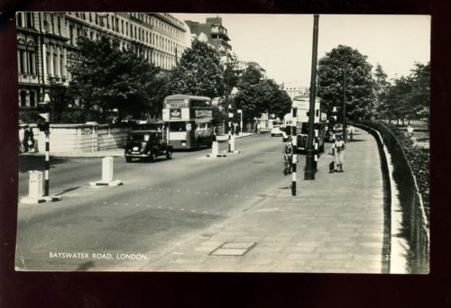
BAYSWATER
“A drab and shady and semi-respectable part called Bayswater which I would rather lie in my coffin, please believe me, than spend a night in.”
“Suze lives in a trio of Victorian bourgeois palaces that have been made over into flatlets for the new priv intellectual lot, and on the old pillars underneath the porticos, instead of numbers 1,2 and 3, or whatever it should be, they’ve written Serpentine House, this ‘House’ thing being the new way of describing any dump the landlords want to make a fast fiver out of.”
Notes:
http://modernism-in-metroland.tumblr.com/post/48841468571/hallfield-estate-paddington-1951-58-by-tecton
https://i.ebayimg.com/images/g/wMsAAOxy66pRrOVT/s-l500.jpg

Slide 14
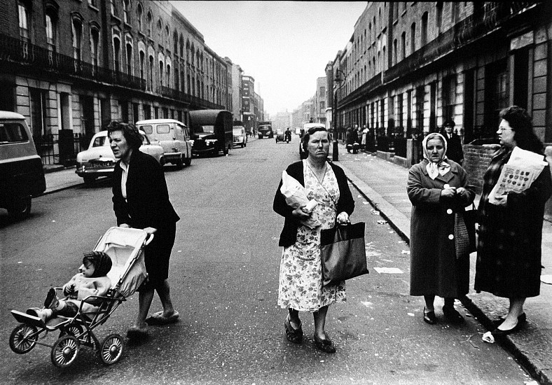
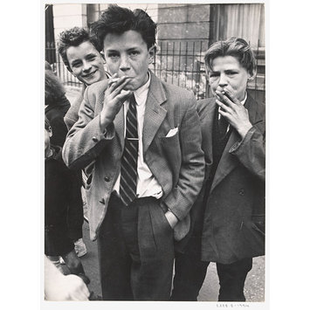
W.10 AND W.11
“However horrible the area is, you’re free there.”
“It’s quite a curiosity, being one of the few that’s got left behind by the Welfare era and the Property-owning whatsit, both of them, and is, in fact, nothing more than a stagnating slum. It’s dying, this bit of London and that’s the most important thing to remember about what goes on there.”
Notes:
http://collections.vam.ac.uk/item/O218920/boys-smoking-portland-road-april-photograph-mayne-roger/ (NOTTING HILL)
https://gittermangallery.com/exhibition/25/exhibition_works/178 ROGER MAYNE

Slide 15
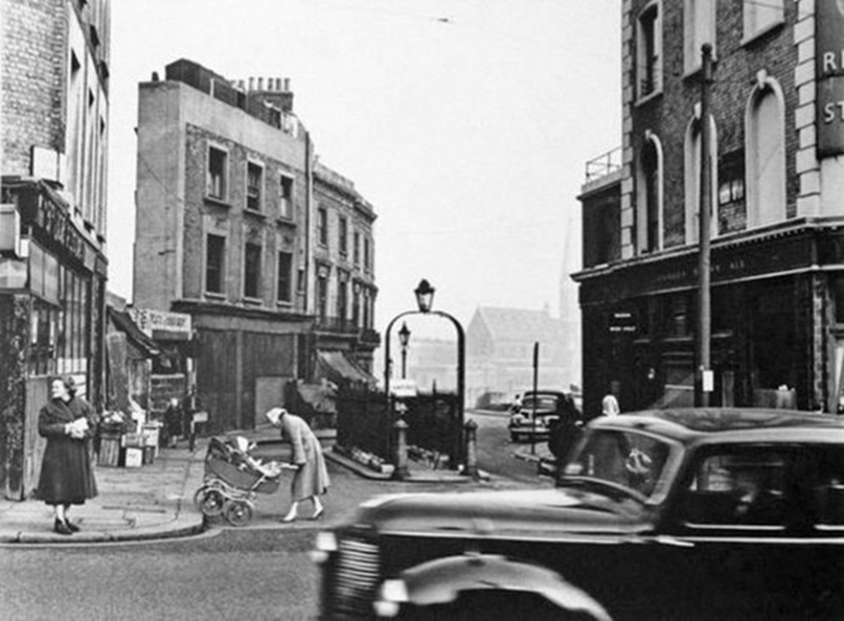
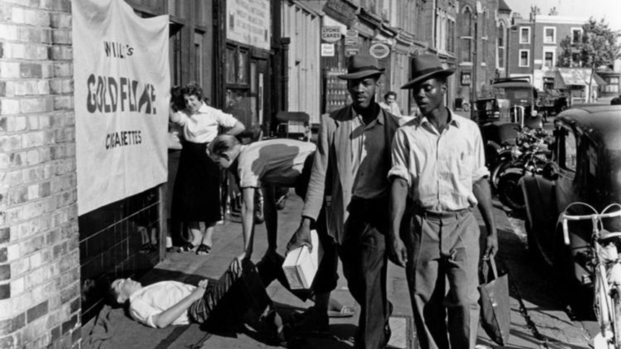
HARROW ROAD
“To the north of it, there run, in parallel the Harrow road I’ve mentioned, which you’d hurry through even if you were in a car and a canal, called the Grand Union, that nothing floats on except cats and contraceptives.”
LATIMER ROAD
“A long lean road called Latimer road which I particularly want you to remember because out of this road, like horrible tits dangling from a lean old sow, there hand a whole festoon of what I think must really be the sinisterest highways in our city.”
Notes:
https://www.timeout.com/london/museums/london-street-photography (LATIMER ROAD)
http://maidahillforum.org.uk/gallery/history-and-heritage.html?page=8 (HARROW ROAD)

Slide 16
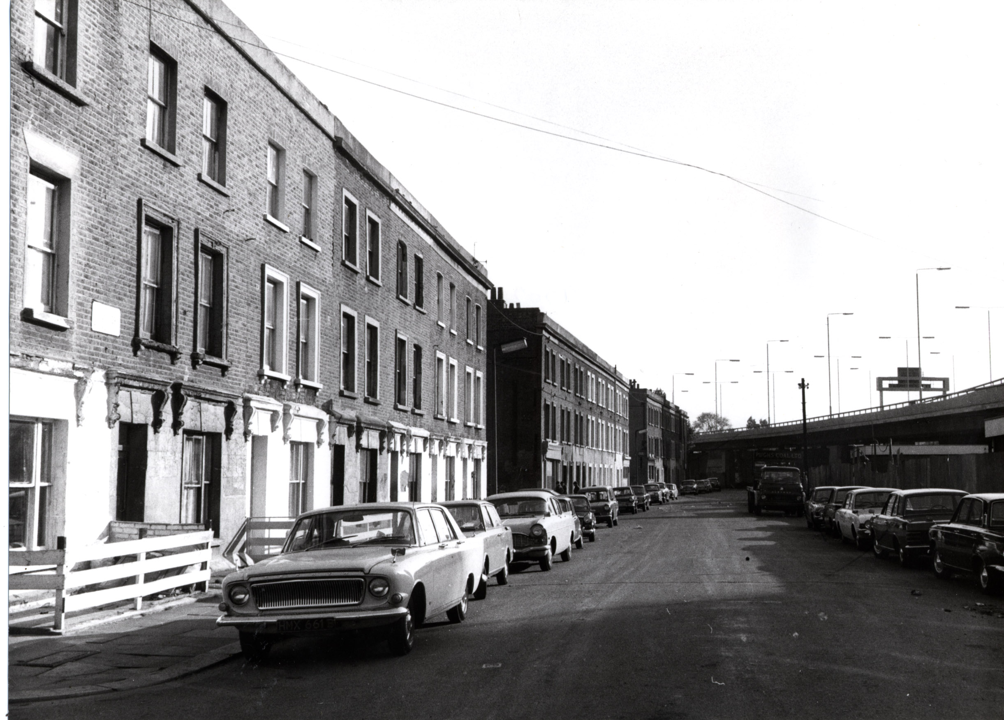
“On the South side of this area, down by the w.11 things are a little different, but in a way that somehow makes them worse, and that is, owing to a freak of fortune and some smart work by the estate agents too, I shouldn’t be surprises, there are one or two sections that are positively posh: not fashionable, mind you, but quite graded, with their big back gardens and that absolute silence which in London is the sign of a respectable location.”

Slide 17
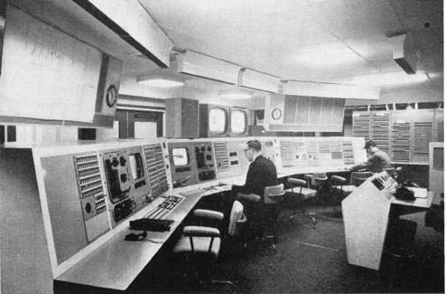
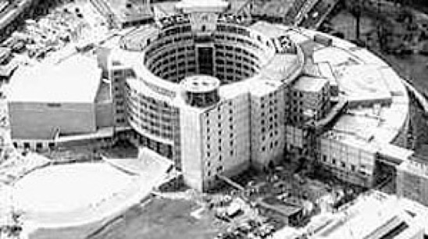
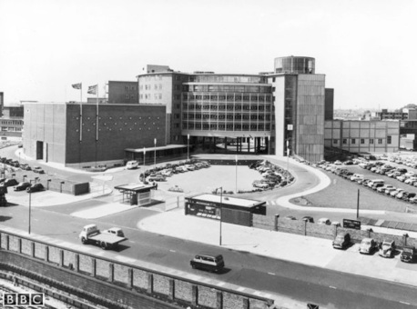
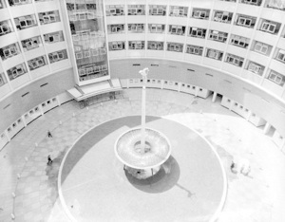
WHITE CITY
WHITE CITY-. “where the old BBC’s building that splendid modernistic palace, so as to send their telly message to the nation.”
Notes:
http://mattgoodmanuk.com/links/BBC-TVCentre.html

Slide 18
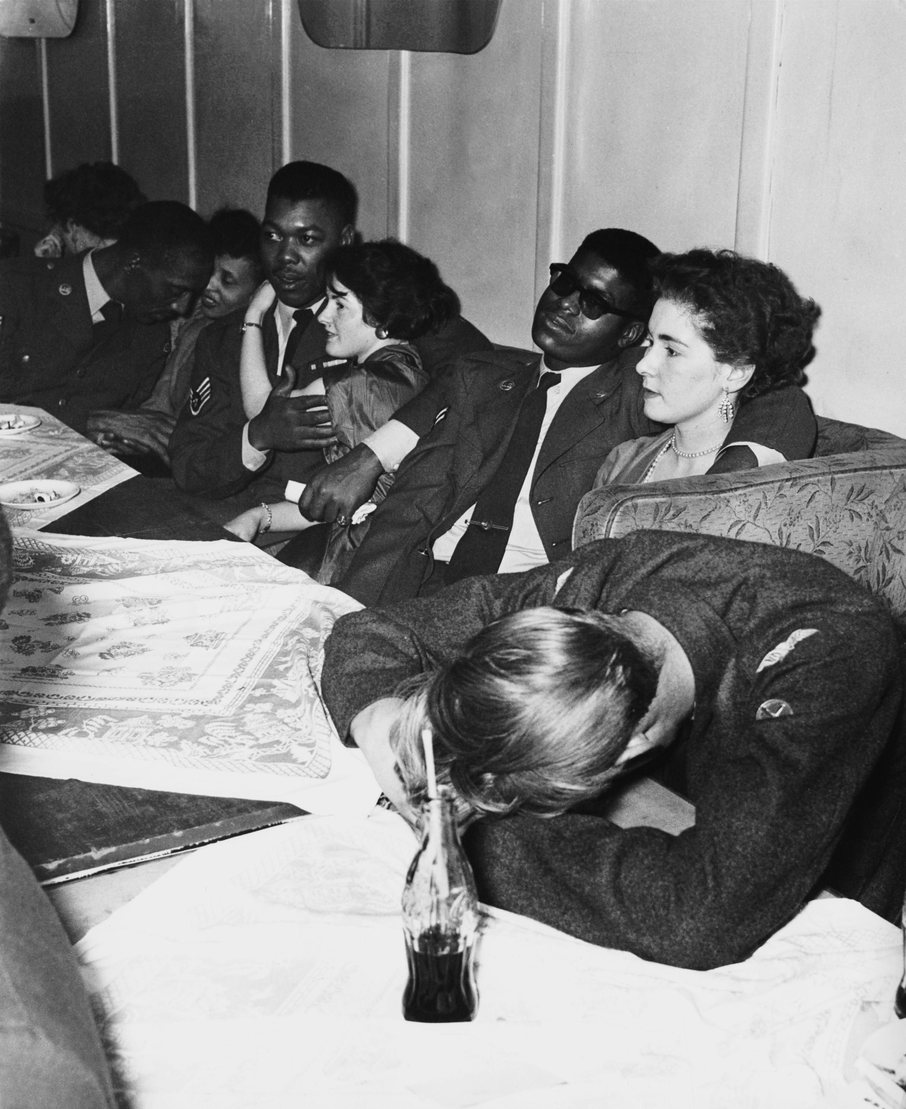
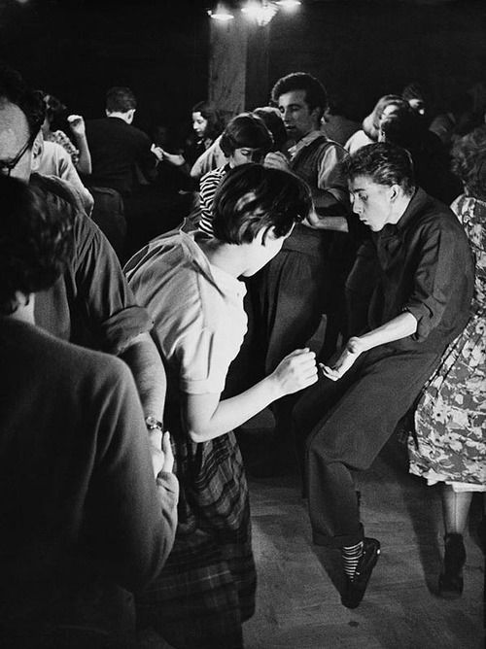
“That brings me to today, and to the third item in my education, my university, you might say, and that’s the jazz clubs.”
THE JAZZ SCENE
“But the great thing about the jazz world, and all the kids that enter into it, is that no one, not a soul, cares what your class is, or what your race is, or what your income, or if you’re a boy or a girl, or bent, or versatile, or what you are – so long as you dig the scene and can behave yourself, and have left all that crap behind you, too, when you come in the jazz club door.”
Notes:
https://flashbak.com/fascinating-photos-of-soho-in-the-1950s-52378/

Slide 19
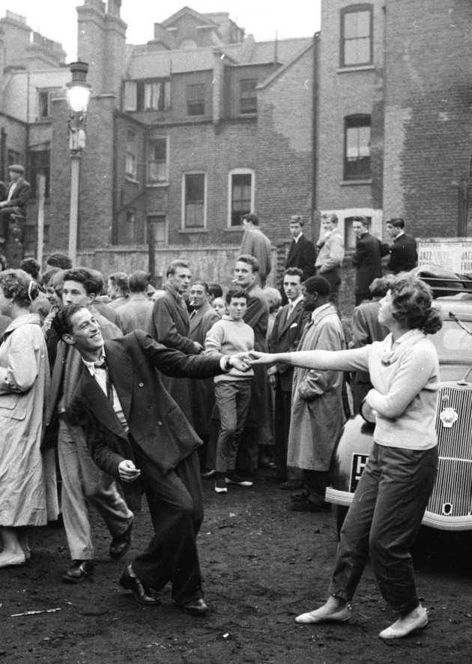
“For centuries the English have been rich, and the price of riches is that you export reality to where it is you get your money from. And now that the marketplaces overseas are closing one by one, reality comes home again to roost, but no one notices it, although it’s settled in to stay beside them.”

Slide 20
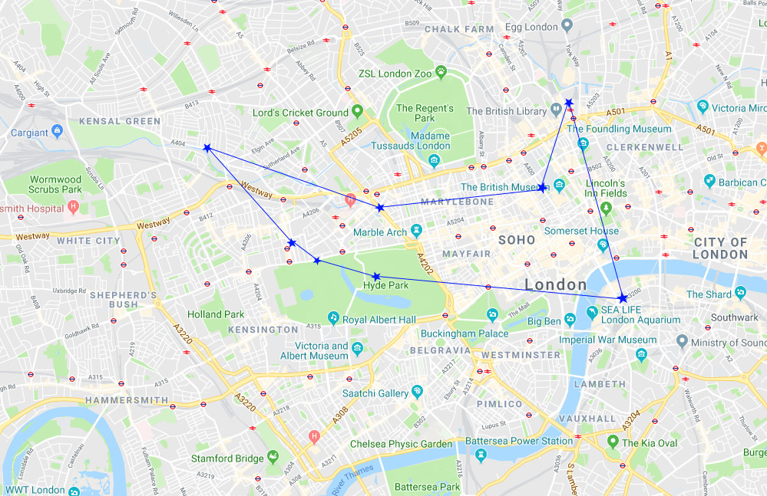
LONELY LONDONERS: THE WEST INDIAN MIGRANT EXPERIENCE
“London is a place like that. It divide up in little worlds , and you stay in the world you belong to and you don’t know anything about what happening in the other ones except what you read in the papers.”- Lonely Londoners
“To have said: ‘I walked on Waterloo Bridge,’ ‘I rendezvoused at Charing Cross,’ ‘Picadilly Circus is my playground,’ to say these things, to have lived these things, to have lived in the great city of London, centre of the world. To one day lean against the wind walking up the Bayswater Road (destination unknown), to see the leaves swirl and dance and sin on the pavement (sight unseeing) to write a causal letter home beginning: ‘Last night, in Trafalgar Square..’

Slide 21
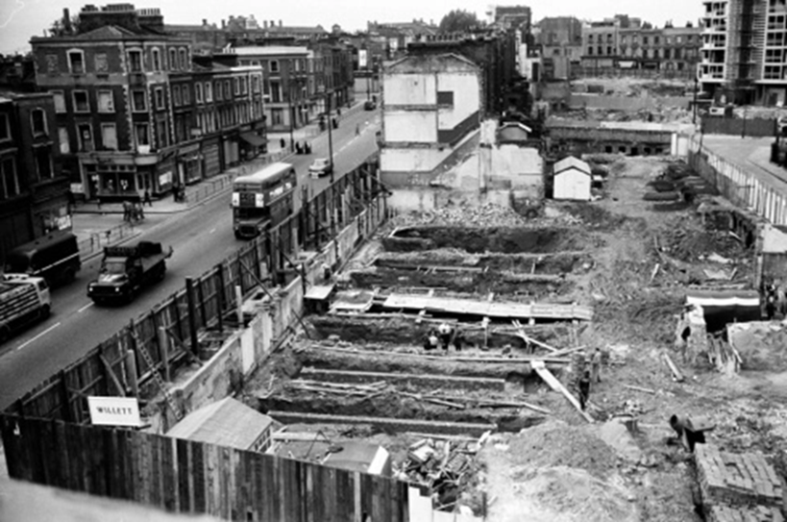
HARROW ROAD
“The street does always be dirty except if rain fall.”
“The place where Tolroy and the family was living was off the Harrow Road, and the people in that area call the Working Class. Wherever in London that it have Working Class, there you will find a lot of spades. This is the real world, where men know what it is to hustle a pound to pay the rent when Friday come. The houses round here old and grey and weather beaten, the walls cracking like the last days of Pompeii, it ain’t have no hot water, and in the whole street that Tolroy and them living in, none of the houses have bath. ”
Notes:
https://rbkclocalstudies.wordpress.com/2014/02/20/unfamiliar-streets-paddington-1959/

Slide 22
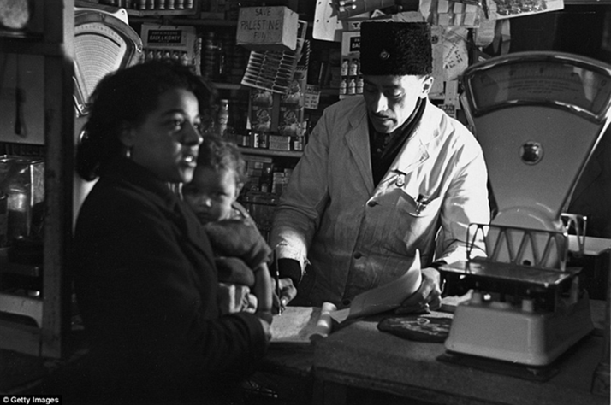
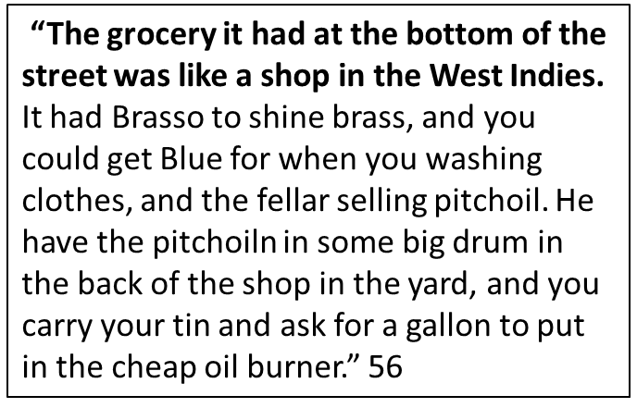
Notes:
http://www.dailymail.co.uk/news/article-4008594/Incredible-photos-British-immigrants-Caribbean-Asia-Europe-came-WWII.html

Slide 23
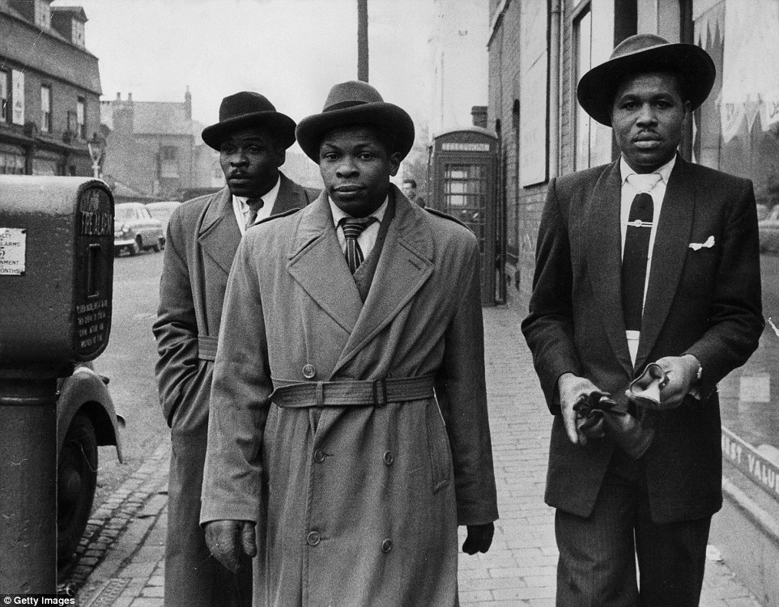
BAYSWATER ROAD: MOSES HOUSE
“Nearly every Sunday morning, like if they go to church, the boys liming in Moses room, coming together for a oldtalk the find out the latest gen, what happening, when is the next fete […] Always every Sunday morning they coming to Moses, like it is a confession, sitting down on the bed, on the floor, on the chairs, everybody asking what happening but nobody like they know what happening,.”
Notes:
http://www.dailymail.co.uk/news/article-4008594/Incredible-photos-British-immigrants-Caribbean-Asia-Europe-came-WWII.html

Slide 24
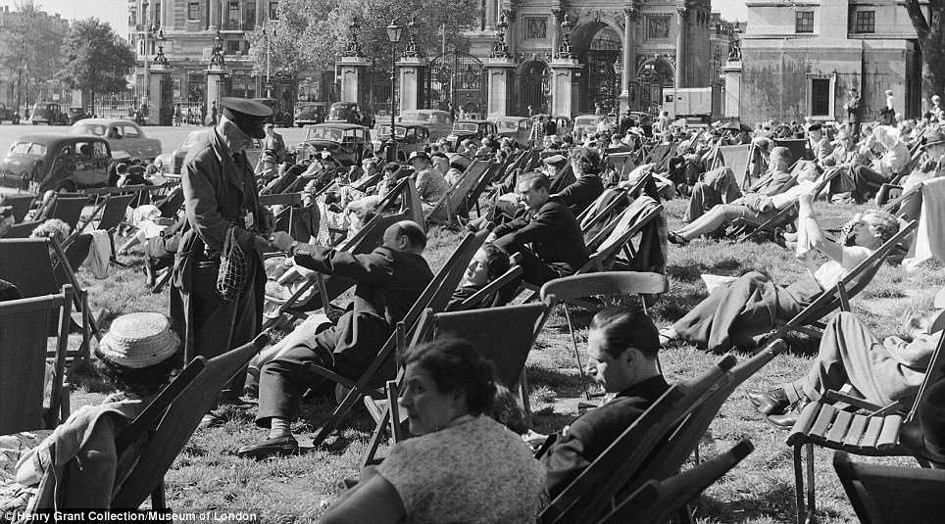
HYDE PARK
“You could go walking through the gardens and see all them pretty pieces of skin taking suntan and how the old geezers like the sun they would sit on the benches and smile everywhere you turn the English people smiling isn’t it a lovely day as if the sun burn away all the tightness and strain that was in their faces for the winter.” 92
Notes:
http://i.dailymail.co.uk/i/pix/2013/08/11/article-2389287-1B3E5E1B000005DC-867_964x535.jpg

Slide 25
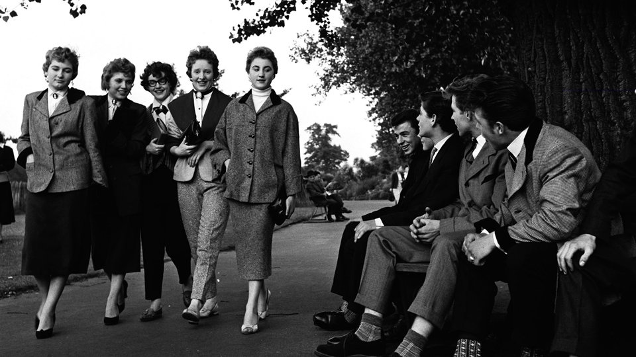
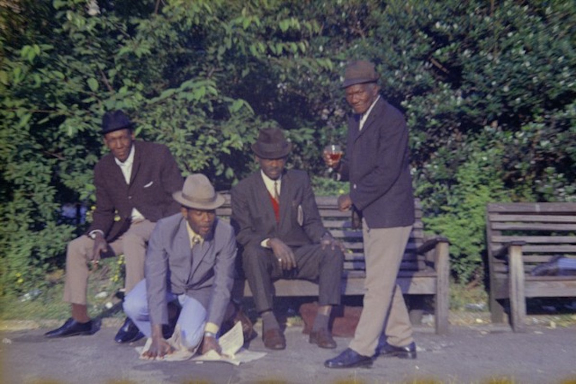
Notes:
http://www.edwardianteddyboy.com/
https://blog.autograph.media/photography-tex-ajetunmobi/

Slide 26
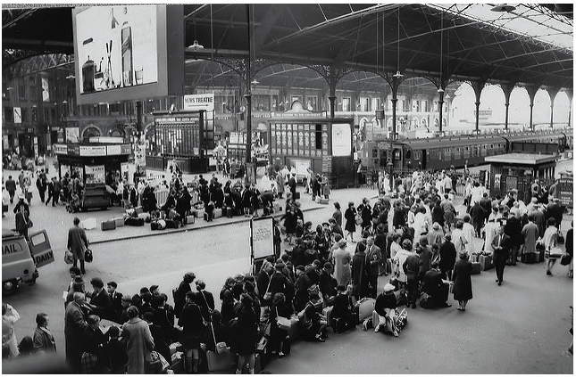
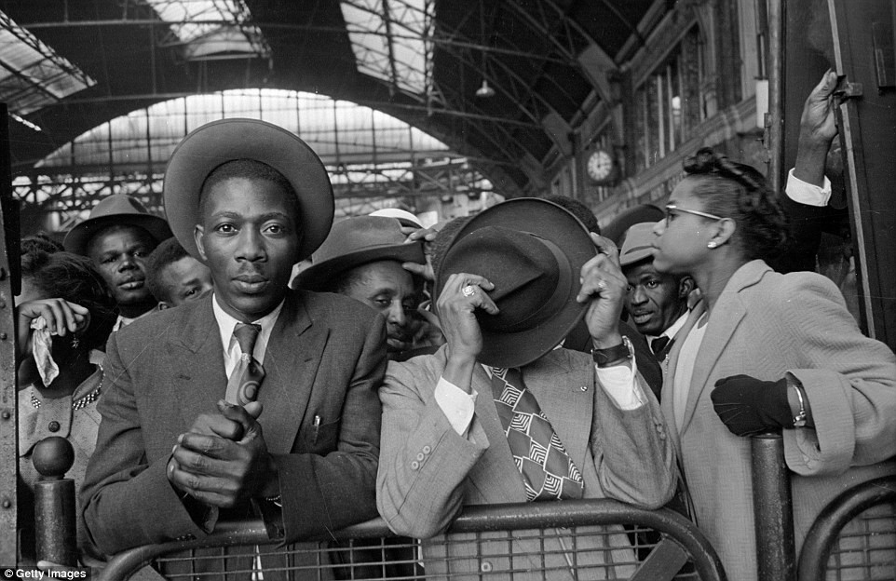
WATERLOO
“This station is that sort of place where you have a soft feeling. It is here that Moses did land when he came to London, and he have no doubt that when the time come, if it ever come, it would be here he would say goodbye to the big city.”
“For the old Waterloo is a place of arrival and departure, is a place where you see people crying goodbye and kissing welcome.”
Notes:
SOURCE:https://www.flickr.com/photos/raymunns/4233413207/sizes/z/
https://www.thesun.co.uk/living/2450632/stunning-black-and-white-photographs-taken-by-film-director-ken-russell-show-teddy-boys-and-girls-in-the-1950s/

Slide 27
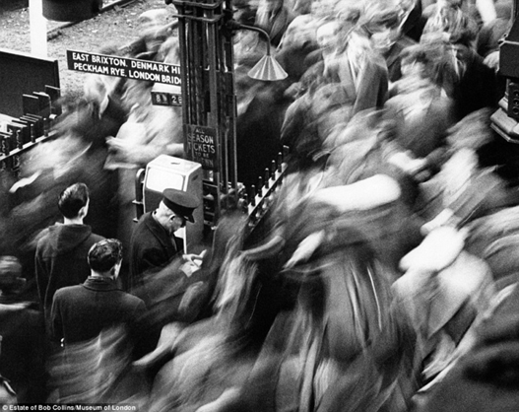
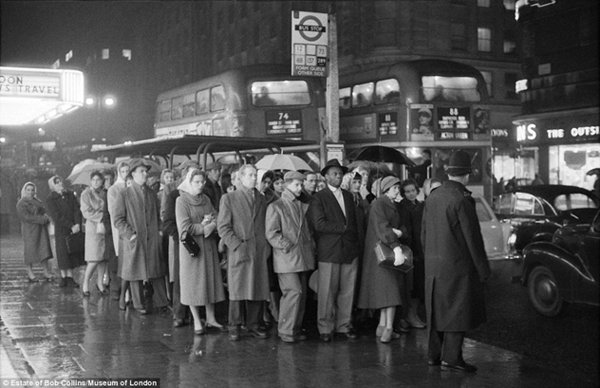
QUEENSWAY
“He stand up there on Queensway watching everybody going about their business, and a feeling of loneliness and fright come on him all of a sudden […] and he realise that here he is, in London and he ain’t have no money or work or lace to sleep or any friend of anything, and he standing u here by the tube station watching people, and everybody look so busy he frighten to ask question from any of them.”
Notes:
http://www.dailymail.co.uk/news/article-2629449/Iconic-images-London-1950s-60s-captured-street-photographer.html

Slide 28
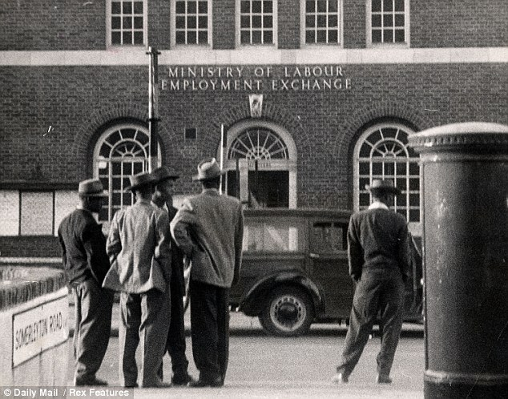
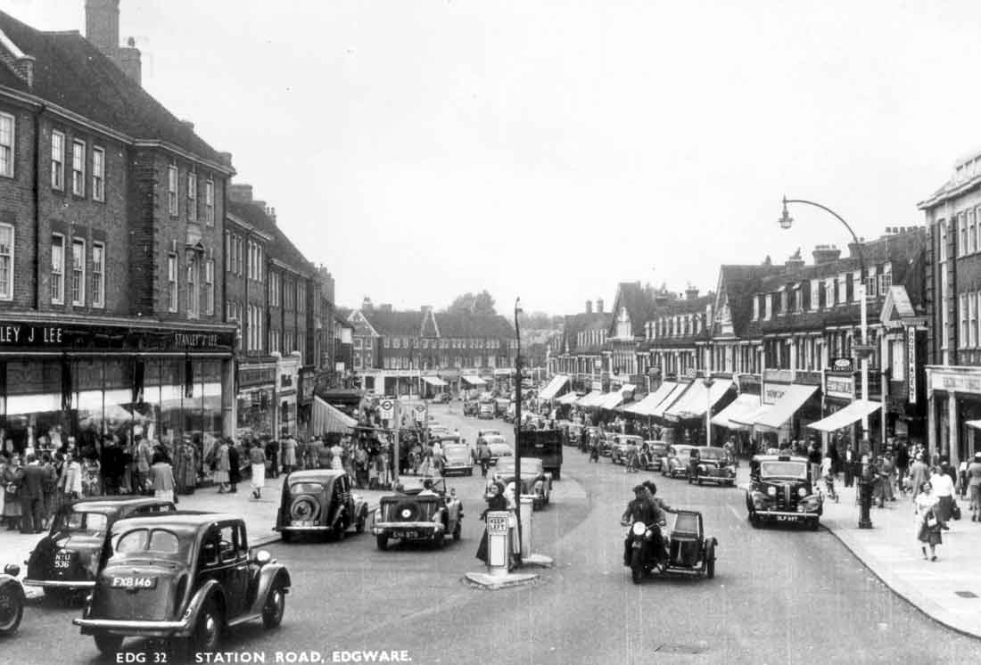
EDGEWARE ROAD: EMPLOYMENT EXCHANGE
“It ain’t have no place in the world that exactly like a place where a lot of men get together to look for work and draw money from the Welfare State while they aint working. Is a kind of place where hate and disgust and avarice and malice and sympathy and sorrow and pity all mix up. Is a place where everyone is your enemy and your friend.”
Notes:
http://www.dailymail.co.uk/news/article-2337755/Era-changed-Britain-forever-How-race-riots-TV-shopping-addiction-gay-rights-transformed-Britain-late-50s.html (FIRST PICTURE IS BRIXTON EMPLOYMENT EXCHANGE: COULDN’T FIND SOMEWHERE FOR EDGEEWARE ROAD)
http://www.1900s.org.uk/images-1940s50s-st-rd-edgware2.htm

Slide 29
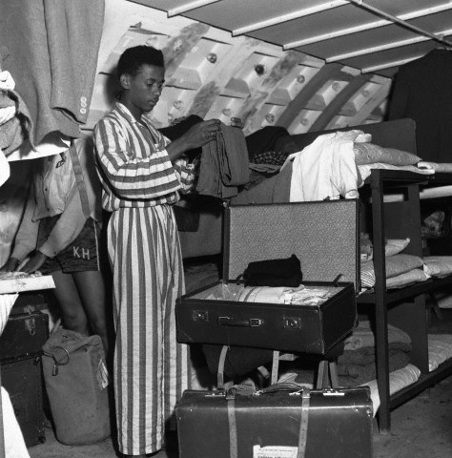
BART’S HOUSE: CAMDEN
“One time in Camden, Bart get a small room, and he fall sick and he nearly dead in that room.”
Notes:
http://www.alamy.com/stock-photo-immigrant-living-temporarily-in-a-nissen-hut-london-1950s-artist-henry-60066045.html

Slide 30
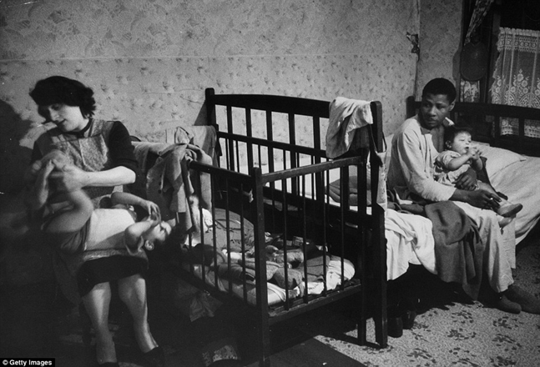
JOSEPH’S HOUSE: PADDINGTON
“Nobody in London does really accept you. They tolerate you, yes, but you can’t go in their house and eat or sit down and talk. It ain’t have no sort of family life for us here. Look at Joseph. He married to a English girl and they have four children, and they living in two rooms in Paddington.”
Notes:
http://www.dailymail.co.uk/news/article-4008594/Incredible-photos-British-immigrants-Caribbean-Asia-Europe-came-WWII.html

Slide 31
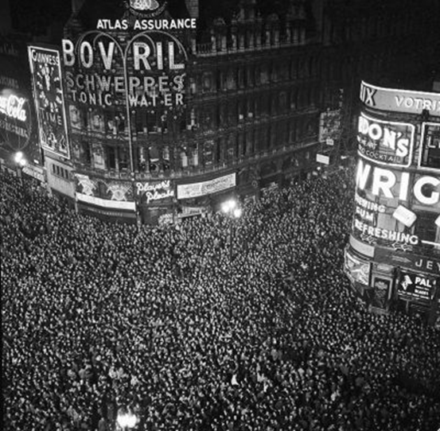
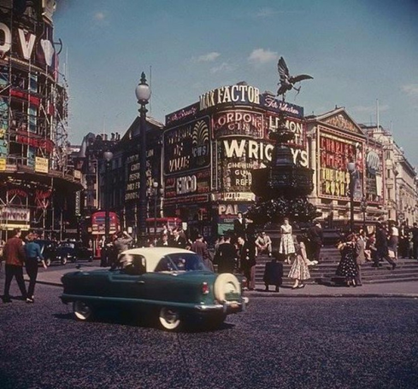
PICADILLY CIRCUS
“when he realise that is he, Sir Galahad, who going there, near that place that everybody in the world know about (it even have the name in the dictionary) he feel like a new man..”
“Is one of those summer evenings, when it look like night would never come, a magnificent evening, a powerful evening, rent finish paying, rations in the cupboard, twenty pounds in the bank, and a nice piece of skin waiting under the big clock in Picadilly Tube Station.”
“that circus have a magnet for him, that circus represent life, that circus is the beginning and the ending of the world.”
Notes:
http://www.ibtimes.co.uk/save-soho-fascinating-old-photos-vibrant-heart-londons-west-end-over-years-1495269
https://londonist.com/london/best-of-london/london-in-the-1950s

Slide 32
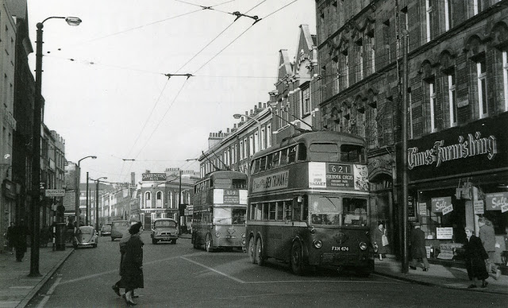
“Well things warm up fast in St Pancras Hall that Saturday night. Around half past ten a Jamaican fellar bust a cocacola bottle over Five head because Five was dancing too close with his girl. Big City finish dancing and he beating pan in the steel band and every now and then jumping up when the weed hit the sky and screaming out for everybody to dance or come and beat pan in the band. Bart drunk as hell and he sitting in a corner holding his head and stating into space. Tanty puling Tolroy away from his woman saying that she tired and want to go home. Lewis like if he is the happiest man in the hall now he get this divorce from Agnes and he going to everybody and telling them how he used to thump she every night.” 113
ST PANCRAS HALL
Notes:
http://www.vintag.es/2016/09/31-black-and-white-photos-show-kings.html

Slide 33
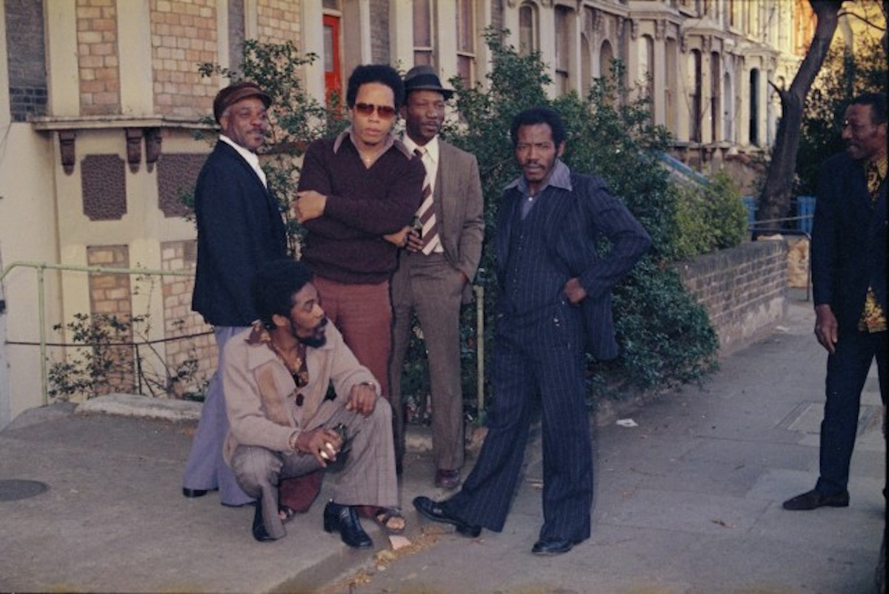
“Like Marble Arch in the summer, any of Harris fete is a get together of all the boys wherever it happen to be”
Notes:
https://blog.autograph.media/photography-tex-ajetunmobi/

Slide 34
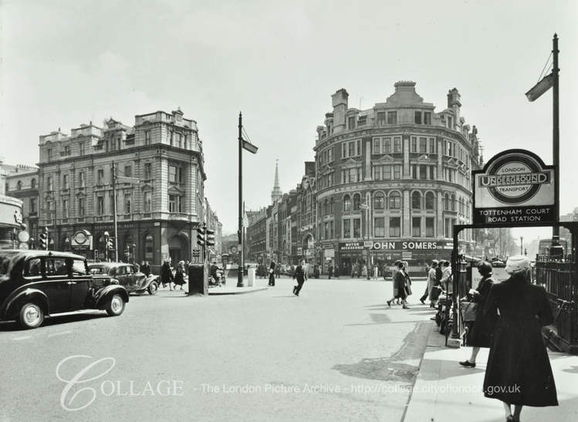

TOTTENHAM COURT ROAD
“I mean them was the days. It don’t have nothing like that again… this aint nothing. The boy’s used to overflow into the road when it had lime there on a Saturday. One time a Jamaican fellar take off all his clothes to fight an Irishman opposite a pub. And talk about weed! Everybody used to be as high as the sky.”
Notes:
https://www.theguardian.com/artanddesign/gallery/2017/may/05/eddie-chambers-black-british-identity-in-pictures

Slide 35

“I just lay there thinking about my life, how after all these years I ain’t get no place at all,
I still the same way, neither forward nor backward.” - Moses
Notes:
https://www.vice.com/en_au/article/av4xpe/photographs-of-black-british-experience-189

